Slide 1

React CoP 2019

Slide 2
Agenda
1. 2018 Review
2. Format change proposal
3. React Projects
4. Plan for next session

Slide 3



2018 Review
Sessions
Attendance
Session Breakdown
11 sessions + kickoff meeting
Average attendance of 12
7 topics and 4 exploratory sessions

Slide 4

2018 Topics
E2E Testing Frameworks
New React Features
React Native
JS Framework Comparison
Context Overview
Hooks
React Test Renderer

Slide 5
Community Standards?

Slide 6



Establish evaluation criteria for topic
Format Proposal
Break out into groups and investigate topic
Two Session Format
Evaluate findings based on criteria and establish standards

Slide 7
Thoughts?
Concerns?

Slide 8
React Projects

Slide 9


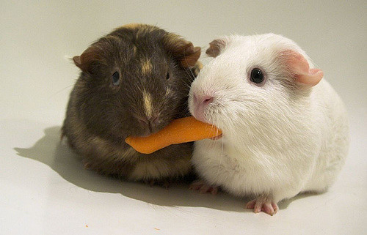
Project Goals
Build
Learn
Share
Work with React by building useful projects for the account or Excella
Enhance React knowledge through direct app experience
Bring what you learn back to the CoP

Slide 10
Thoughts?
Concerns?

